Slide 1

How to Login to Sira UW
(https://underwriting.middlesea.com)
from the 6th August

Slide 2
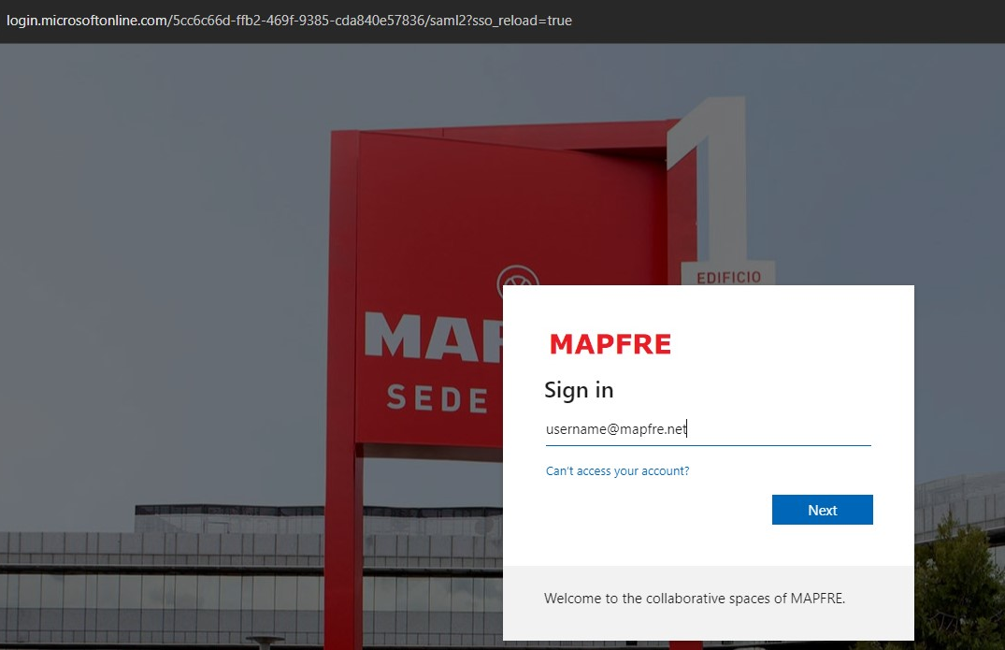
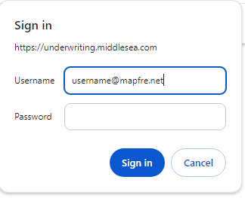
Logging in to SIRA UW on the 6th August
SIRA Underwriting
MAPFRE Login Page
https://underwriting.middlesea.com/
Same password applies
(please allow 10 mins to login after you reset your password)
Use your MAPFRE username in this screen

Slide 3
A dedicated Support Helpline in case of login difficulties has been setup: 25909 919
Thank You

