Slide 1

How to Login to Sira Claims (https://claims.middlesea.com)
from the 21st August

Slide 2
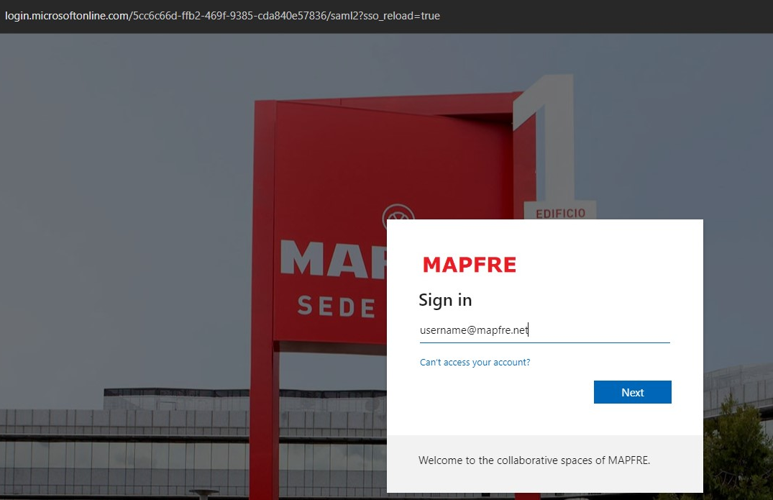
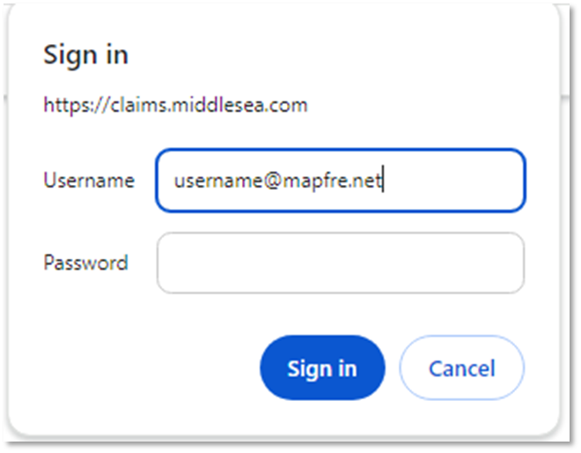
Logging in to SIRA Claims on the 21st August
SIRA Claims
MAPFRE Login Page
https://claims.middlesea.com/
Same password applies
(please allow 10 mins to login after you reset your password)
Use your MAPFRE username in this screen

Slide 3
A dedicated Support Helpline in case of login difficulties has been setup: 25909 919
Thank You

