Slide 1

How to Login to Sira Claims (https://claims.middlesea.com)
from the 21th August

Slide 2
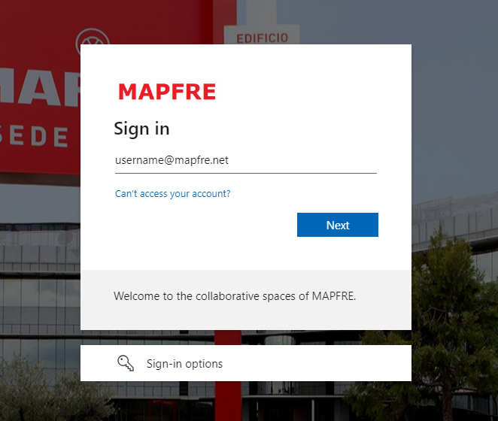
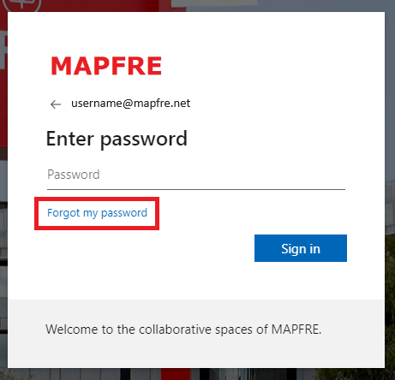
Create Your Password for Your MAPFRE Username
Click on this Link:
Password Reset
Use your MAPFRE username in this screen
Press Forgotten my Password

Slide 3
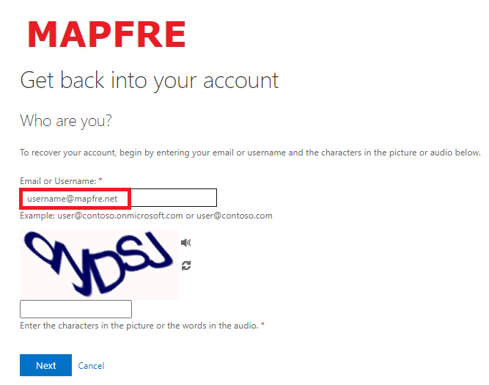
Create Your Password for Your MAPFRE Username
Use your MAPFRE username in this screen and follow on screen instructions

Slide 4
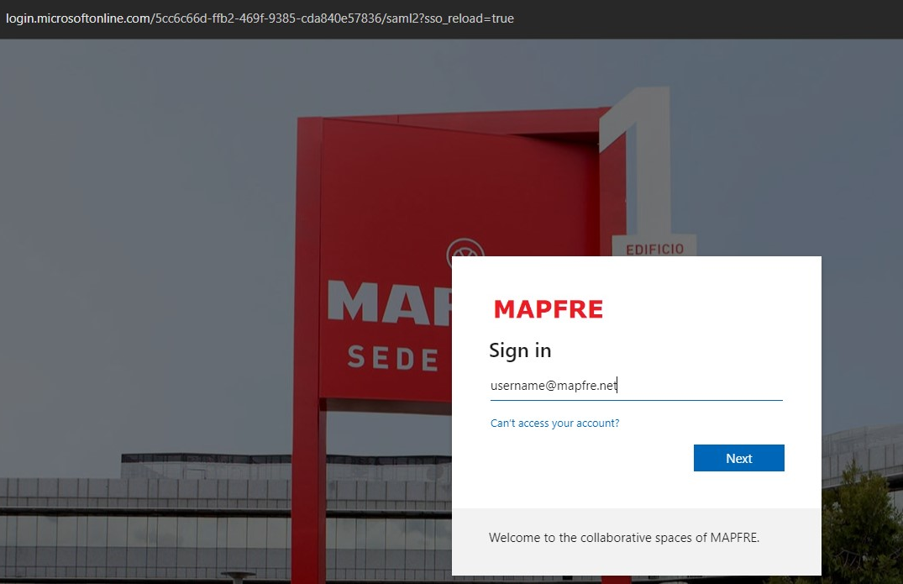
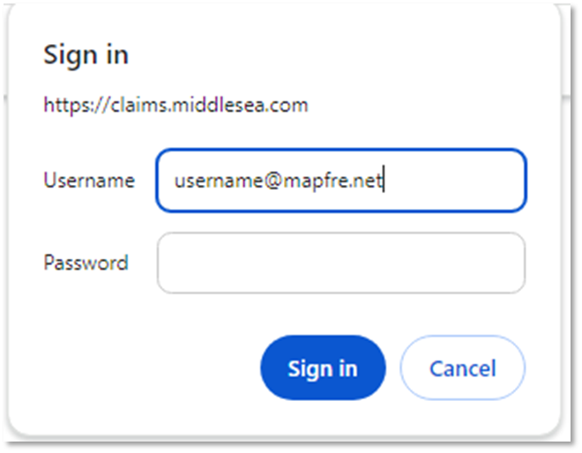
Logging in to SIRA Claims on the 21th August
SIRA Claims
MAPFRE Login Page
https://claims.middlesea.com/
Same password applies
(please allow 10 mins to login after you reset your password)
Use your MAPFRE username in this screen

Slide 5
A dedicated Support Helpline in case of login difficulties has been setup: 25909 919
Thank You

