Slide 1

How to Login to Coresuite, The Portal, THEREFORE and PET
from the 2nd September

Slide 2
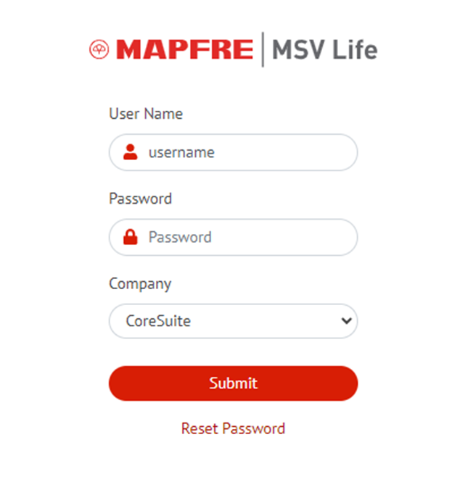
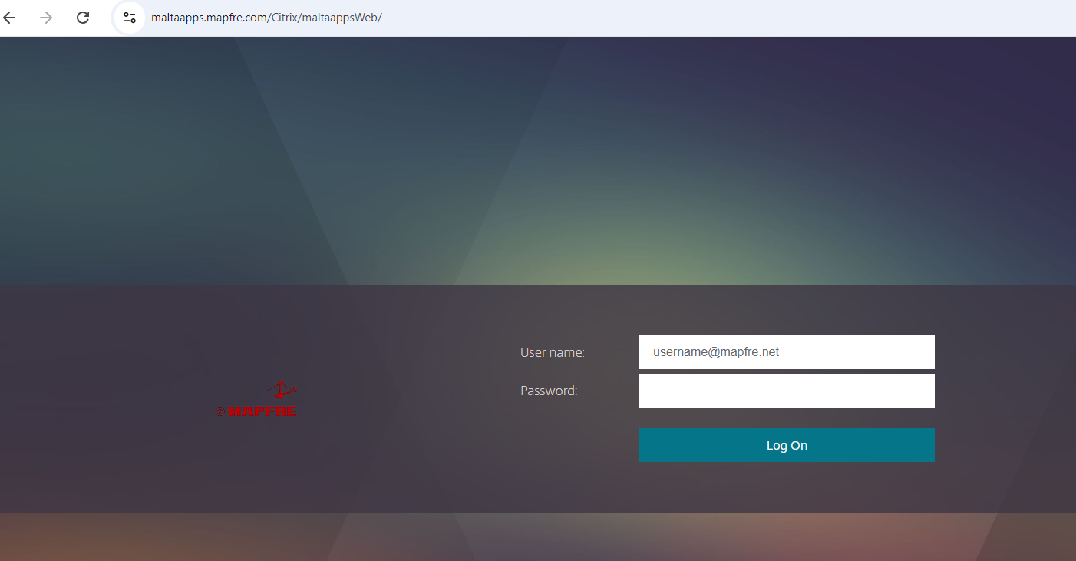
How to login to The Portal after the 2nd September
NEW Login Method to the Portal
Use your mapfre.net username and password used in this screen
Using your MAPFRE account and password without .mapfre.net

Slide 3
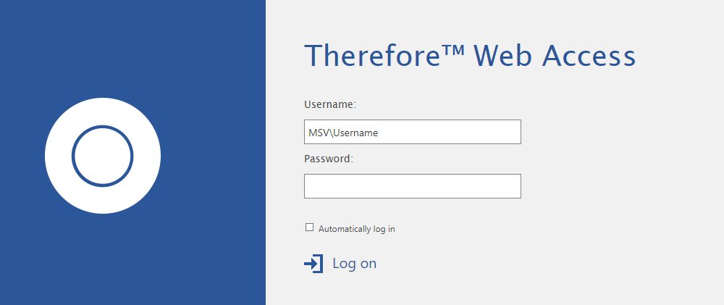

How to Login to Therefore after the 2nd September
Current Login Method
NEW Login Method
to DEMA000\Username
(Using your MAPFRE account and password)
From using MSV\username

Slide 4
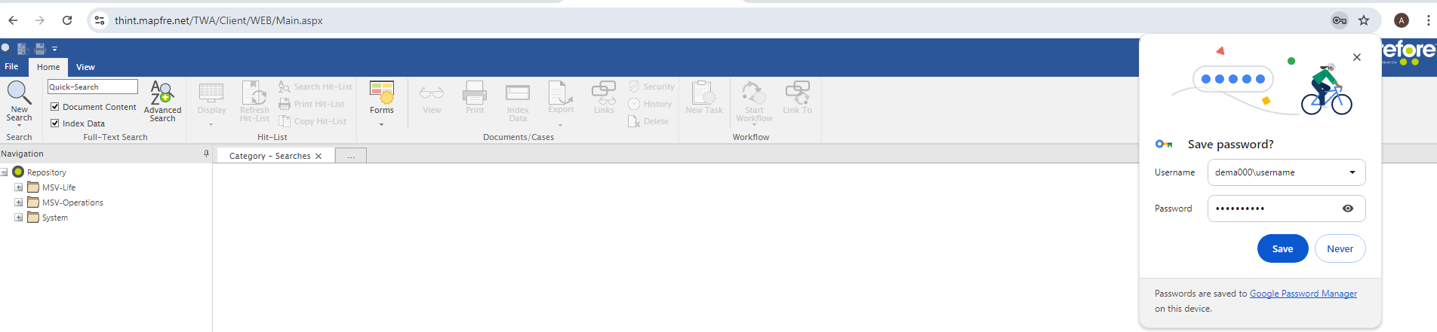
How to Login to Therefore after the 2nd September
After you login successfully, please remember to save your credentials for the next time you login !

Slide 5
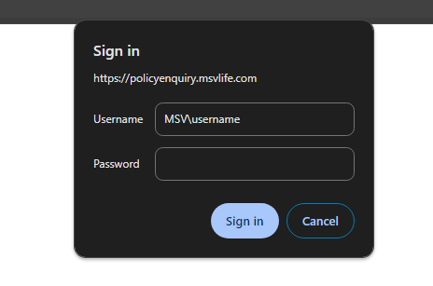
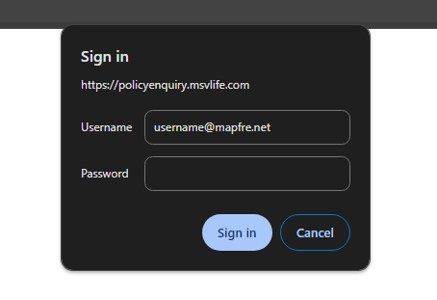
How to Login to PET after the 2nd September
Current Login Method
NEW Login Method
From MSV\username to username@mapfre.net
Same password applies

Slide 6
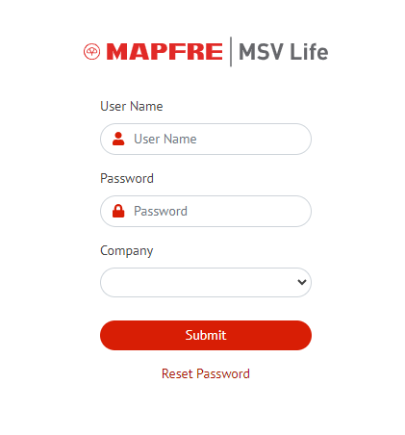
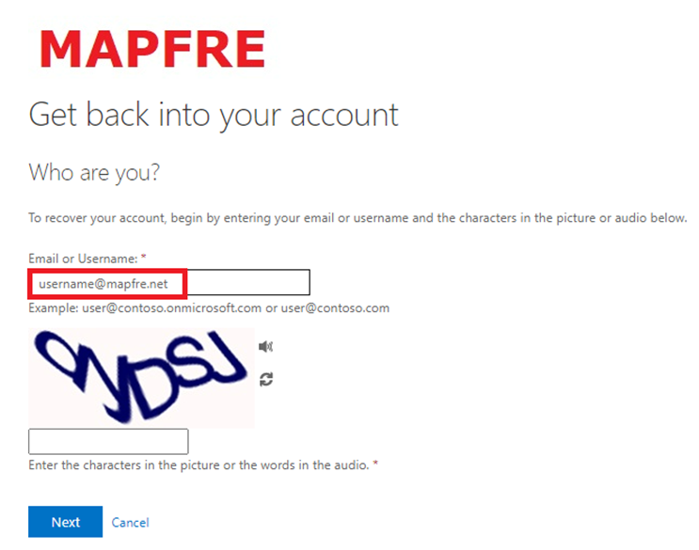
How to reset your password after the 2nd September
Reset Password button will redirect to this page:
Enter username in this format: username@mapfre.net

Slide 7
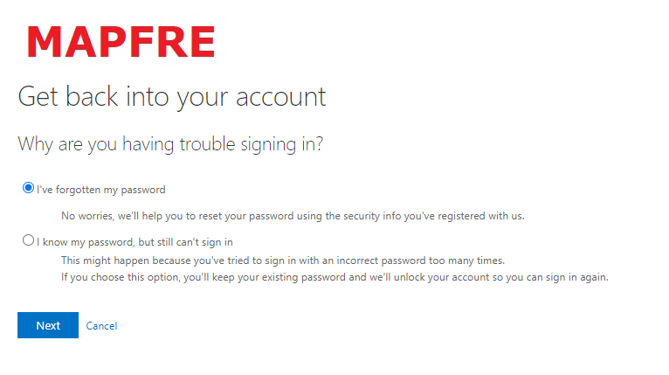
How to reset your password after the 2nd September
Choose “I’ve forgotten my password” and follow on-screen instructions

Slide 8
A dedicated Support Helpline in case of login difficulties has been setup: 25909 919
Thank You

