Slide 1

How to Login to BridgeIT
(https://bridgeit.mapfre.com:4430/)
from the 6th August

Slide 2
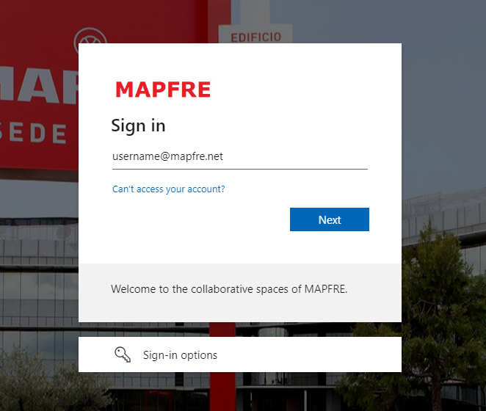
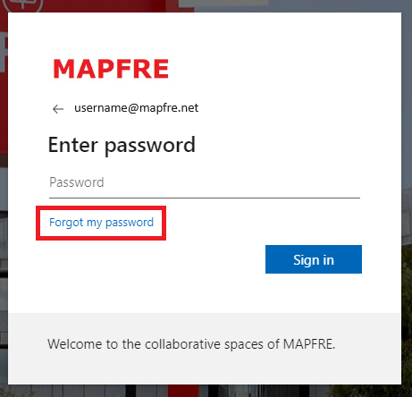
Create Your Password for Your MAPFRE Username
Click on this Link:
Password Reset
Use your MAPFRE username in this screen
Press Forgotten my Password

Slide 3
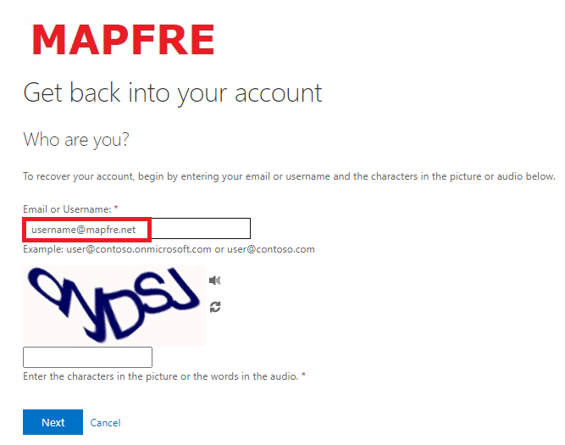
Create Your Password for Your MAPFRE Username
Use your MAPFRE username in this screen and follow on screen instructions

Slide 4
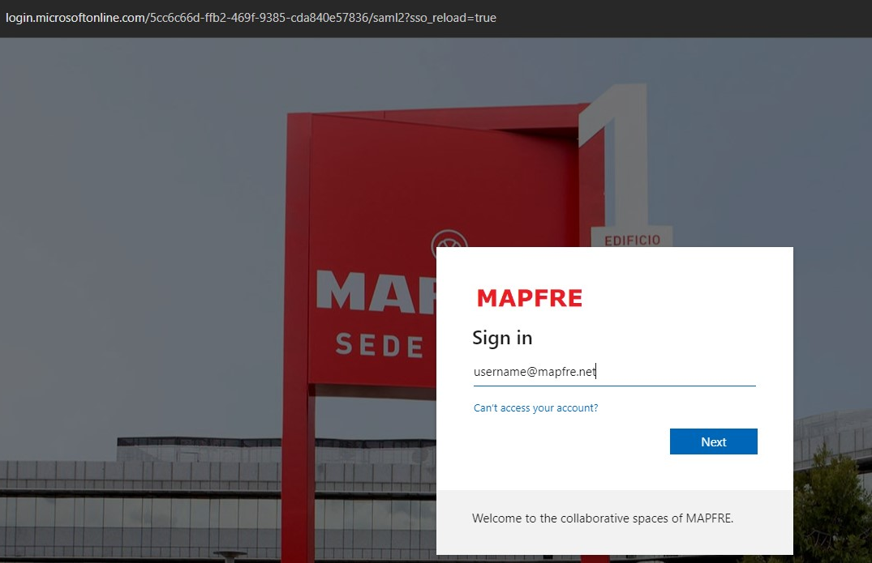
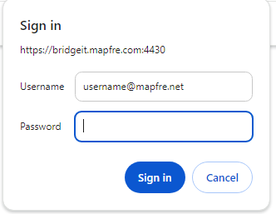
Logging in to BridgeIT on the 6th August
https://bridgeit.mapfre.com:4430
MAPFRE Login Page
BridgeIT
Same password applies
(please allow 10 mins to login after you reset your password)
Use your MAPFRE username in this screen

Slide 5
A dedicated Support Helpline in case of login difficulties has been setup: 25909 919
Thank You

